Slide 1

Money and Inflation

Slide 2
Money
What is Money?
Stock of assets
Used for transactions
A type of wealth
As a medium of exchange, money is used to buy goods and services. The ease at which an asset can be converted into a medium of exchange and used to buy other things is sometimes called an asset’s liquidity. Money is the economy’s most liquid asset.

Slide 3
Monetization increases efficiency!!!
Money is the yardstick with which we measure economic transactions. Without it, we would be forced to barter.
However, barter requires the double coincidence of wants—the unlikely situation of two people, each having a good that
the other wants at the right time and place to make an exchange.

Slide 4
Functions of Money
It serves as a store of value, unit of account, and a medium of exchange. The ease with which money is converted into other things such as goods and services--is sometimes called money’s liquidity.

Slide 5


Types of Money
Commodity money is money that
has intrinsic value. (e.g., cigarettes in POW camps)
Fiat money is money by declaration.
It has no intrinsic value. (e.g., coins & bills)
When people use gold as money, the
economy is said to be on a gold standard.

Slide 6

The government may get involved in the monetary system to help people reduce transaction costs. Using gold as a currency is costly because the purity and weight has to be verified. Also, coins are more widely recognized than gold bullion.
The government then accepts gold from the public in exchange for gold-certificates— pieces of paper that can be redeemed for actual gold. If people trust that the government will give them the gold upon request, then the currency will be just as valuable as the gold itself—plus, it is easier to carry around the paper than the gold. The end result is that because no one redeems the gold anymore and everyone accepts the paper, they will have value and serve as money.

Slide 7
Monetary Policy
Money Supply vs.
The money supply is the quantity of money available in an economy.
The control over the money supply is called monetary policy.
In India, monetary policy is conducted in a partially independent institution called the central bank. The central bank in India is called the Reserve Bank of India.

Slide 8

What is Inflation?
Here is a great illustration of the power of inflation:
In 1970, the New York Times cost 15 cents, the median price of a single-family home was $23,400, and the average wage in manufacturing was $3.36 per hour. In 2008, the Times cost $1.50, the price of a home was $183,300, and the average wage was $19.85 per hour.
1950
1970
2008

Slide 9
Inflation
“Inflation is too much money chasing too few goods”
“Always and everywhere, rapid inflation is produced by excessive creation of government liabilities without a corresponding increase in the amount of goods produced by the economy.”
Inflation can arise due to excessive aggregate demand (demand pull inflation) or due to a sharp rise in input costs (cost pull inflation)

Slide 10
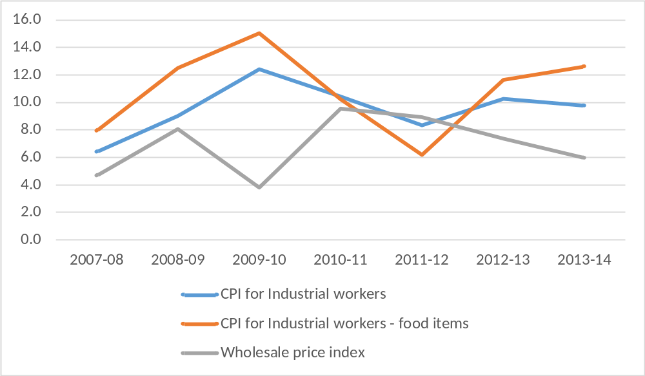
Recent Inflation in India

Slide 11
A Model of Money Supply
Money supply:
M = C+D
The monetary base (B) is money held by the public in currency and by banks as reserves R. It is directly controlled by RBI. Also called high powered money.
B = C + R
Money ss is proportional to the monetary base
each dollar of B produces m dollars of money

Slide 12
Change in Money Supply
The money supply is proportional to the monetary base. So, an increase in B increases M m-fold.
The lower the reserve-deposit ratio, the more loans banks make and the higher is the money multiplier
The lower the currency deposit ratio, the fewer rupee public holds as currency and the lower is the money multiplier

Slide 13
The Demand for Money
The demand for money is the quantities of money people are willing and able to hold at alternative interest rates, ceteris paribus.
A portfolio decision is the choice of how (where) to hold idle funds.

Slide 14
How does bank create money
Bank 1
Assets |  | Liabilities
Reserves | 200 | Deposits | 1000
Loans | 800
Bank 2
Assets |  | Liabilities
Reserves | 160 | Deposits | 800
Loans | 640
Bank 3
Assets |  | Liabilities
Reserves | 128 | Deposits | 640
Loans | 512

Slide 15
Original deposit = 1000
Bank 1= (1-rr)*1000
Bank 2 = (1-rr)² *1000
Bank 3 = (1-rr)³ *1000
Total Money Supply = [1+(1-rr)+(1-rr) ²+(1-rr) ³ +….]*1000
= (1/rr)*1000
Each Rs.1 generates (1/rr) amount of money
So, Rs. 1000 generates (1000/0.2) = Rs.5000

Slide 16
How does the RBI change the monetary base?
Open-market operations:
  The RBI could buy securities (usually short-term Treasury bonds) from banks or from the public
  This increases “reserves” (R↑) in the assets column of the banks’ balance sheets, and
  Increases cash held by the public (C↑)
  Therefore, the monetary base increases (B = C + R↑)

Slide 17
Giving loans to banks and thereby increasing banks’ reserves (R↑)
This typically happens when banks have lost the trust of private lenders and are unable to borrow from them
The RBI is the “lender of last resort”
The RBI’s lending can take two forms:
  Discount Window
  Term Auction Facility

Slide 18
Discount Window
The RBI lends to banks directly and charges them an interest rate called the discount rate
  When the RBI reduces the discount rate, banks borrow more, their reserves rise by a bigger amount, and so the monetary base rises by a bigger amount

Slide 19
Term Auction Facility
This is a recent response to the financial crisis of 2008-9
The Fed decides how much it wants to lend to banks, and eligible banks then bid to borrow those funds, with the loans going to the banks that offer to pay the highest interest
In this way, both banks’ reserves and the monetary base increase

Slide 20
How does the Fed indirectly control rd? Reserve Requirements
Reserve requirements are Fed regulations that impose a minimum reserve-deposit ratio on banks
  This is to ensure that there will always be enough money in banks for depositors who may need to withdraw cash
The required minimum rd is only a minimum
Still, when reserve requirements decrease, rd tends to fall.
This causes m, M and B to increase

Slide 21
How does the Fed indirectly control rd? Interest on Reserves
This is a recent response to the financial crisis of 2008-9
US banks keep their reserves with the Fed
The Fed now pays banks interest on the reserves they keep at the Fed
A reduction in this interest, induces banks to keep fewer reserves
This reduces rd, and increases m, M, and B

Slide 22
Changing Statutory liquidity ratio
Selective Credit Control
Increasing Repo

Slide 23
The Quantity Theory of Money
The quantity equation is an identity: the definitions of the four variables make it true. If one variable changes, one or more of the others must also change to maintain the identity. The quantity equation we will use from now on is the money supply (M) times the velocity of money (V) which equals price (P) times the number of transactions (T):
Money × Velocity = Price × Transactions
M × V = P × T
V in the quantity equation is called the transactions velocity of money. This tells us the number of times a dollar bill changes hands in a given period of time.

Slide 24
Transactions and output are related, because the more the
economy produces, the more goods are bought and sold.
If Y denotes the amount of output and P denotes the price of one
unit of output, then the dollar value of output is PY. We
encountered measures for these variables when we discussed
the national income accounts.
Money × Velocity = Price × Output
M × V = P × Y
This version of the quantity equation is called the income
velocity of money, which tells us the number of times a dollar
bill enters someone’s income in a given time.

Slide 25
The Money Demand Function
and the Quantity Equation
Let’s now express the quantity of money in terms of the quantity of
goods and services it can buy. This amount, M/P is called real money
balances. Real money balances measure the purchasing power of the
stock of money.
A money demand function is an equation that shows the determinants of real money balances people wish to hold. Here is a simple money demand function:
where k is a constant that tells us how much money people want to hold for every rupee they earn. This equation states that the quantity of real money balances demanded is proportional to real income.
(M/P)^{d} = k Y

Slide 26
The Money Demand Function
and the Quantity Equation
The money demand equation offers another way to view the quantity equation
MV= PY
where V = 1/k.
This shows the link between the demand for money and the velocity
of money. When people hold a lot of money for each rupee of income (k is large), money changes hands infrequently (V is small).
Conversely, when people want to hold only a little money (k is
small), money changes hands frequently (V is large).

Slide 27
Money, Prices and Inflation
The factors of production and the production function determine
the level of output Y.
the velocity of money is fixed.
Thus, the price level P is then directly dependent on M.

Slide 28

In other words, if Y is fixed because it depends on the growth in the factors of production and on technological progress, and we just made the assumption that velocity is constant,
MV = PY
or in percentage change form:
% Change in M + % Change in V = % Change in P + % Change in Y
The quantity theory of money states that the central bank, which
controls the money supply, has the ultimate control over the inflation rate. If the central bank keeps the money supply stable,the price level will be stable. If the central bank increases the money supply rapidly, the price level will rise rapidly.

Slide 29
Seigniorage: The Revenue From Printing Money
The revenue raised through the printing of money is called seigniorage. When the government prints money to finance expenditure, it increases the money supply. The increase in the money supply, in turn, causes inflation. Printing money to raise revenue is like imposing an inflation tax.

Slide 30


Controlling Inflation: Open Market Operations
To expand the money supply:
The RBI buys Govt bonds and pays for them with new money.
To reduce the money supply:
The RBI sells Govt Bonds and receives the existing rupee.
US. Treasury Bond
The bearer of the United States
Treasury bond is hereby promised
the repayment of the principle
value plus the interest which it
incurs through the terms stated
thereof.
The United States will justly repay
its bearers in its entirety and
will not default under any
circumstances.
Signature of the President
___________________

Slide 31
The RBI controls the money supply in 3 ways:
Conducting Open Market Operations
Changing the Reserve requirements
Changing the Discount rate which member banks (not meeting the reserve requirements) pay to borrow from the RBI.
Changing SLR

Slide 32

Inflation and
Interest Rates

Slide 33
Real and Nominal Interest Rates
Economists call the interest rate that the bank pays the
Nominal interest rate and the increase in your purchasing power the
real interest rate.
This shows the relationship between the nominal interest rate
and the rate of inflation, where r is real interest rate, i is the
nominal interest rate and π is the rate of inflation, and remember
that π is simply the percentage change of the price level P.
r = i - π

Slide 34

The Fisher Effect
The Fisher Equation illuminates the distinction between
the real and nominal rate of interest.
Fisher Equation:
i = r + π
The one-to-one relationship
between the inflation rate and the nominal interest rate is
the Fisher effect.
Actual (Market)
nominal rate of
interest
Real rate
of interest
Inflation
It shows that the nominal interest can change for two reasons: because
the real interest rate changes or because the inflation rate changes.

Slide 35
The quantity theory and the Fisher equation together tell us how money growth affects the nominal interest rate.
According to the quantity theory, an increase in the rate of money growth by 1% causes a 1% increase in the rate of inflation.
According to the Fisher equation, a 1% increase in the rate of inflation in turn causes a 1% increase in the nominal interest rates.
% Change in M + % Change in V = % Change in P + % Change in Y
% Change in M + % Change in V = π + % Change in Y
i = r + π

Slide 36
i = r + Eπ
The ex ante real interest rate r is determined by equilibrium in the
market for goods and services.
The nominal interest rate i moves one-for-one with changes in expected inflation Eπ.

Slide 37
Future Money and Current Prices
Money supply and money demand
Interest
Rates
Prices
Thus, inflation rate

Slide 38




Costs of Expected Inflation
The inconvenience of reducing money holding is metaphorically called the shoe-leather cost of inflation, because walking to the bank more often induces one’s shoes to wear out more quickly.
When changes in inflation require printing and distributing new pricing information, then, these costs are called menu costs.
Another cost is related to tax laws. Often tax laws do not take into consideration inflationary effects on income.

Slide 39

The Costs of Unexpected Inflation
Unanticipated inflation is unfavorable because it arbitrarily
redistributes wealth among individuals.
For example, it hurts individuals on fixed pensions. Often these
contracts were not created in real terms by being indexed to a
particular measure of the price level.
There is a benefit of inflation—many economists say that some
inflation may make labor markets work better. They say it
“greases the wheels” of labor markets.

Slide 40

Hyperinflation
Hyperinflation is defined as inflation that exceeds 50 percent per month, which is just over 1percent a day.
Costs such as shoe-leather and menu costs are much worse with hyperinflation—and tax systems are grossly distorted. Eventually, when costs become too great with hyperinflation, the money loses its role as store of value, unit of account and medium of exchange. Bartering or using commodity money becomes prevalent.

Slide 41
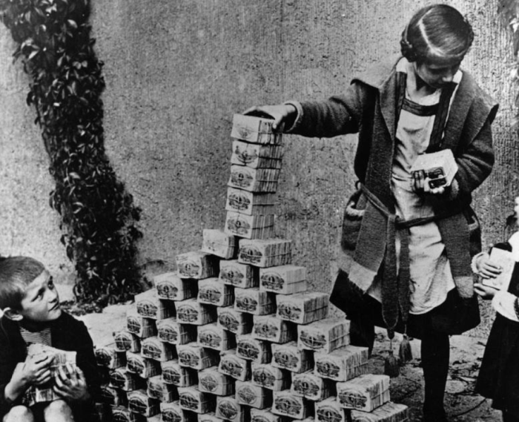
CASE STUDY 1: THE GREAT GERMAN HYPERINFLATION
Image source: http://iconicphotos.files.wordpress.com/2011/08/img_0142.png?w=700&h=568
Retrieved October 10, 2014

Slide 42
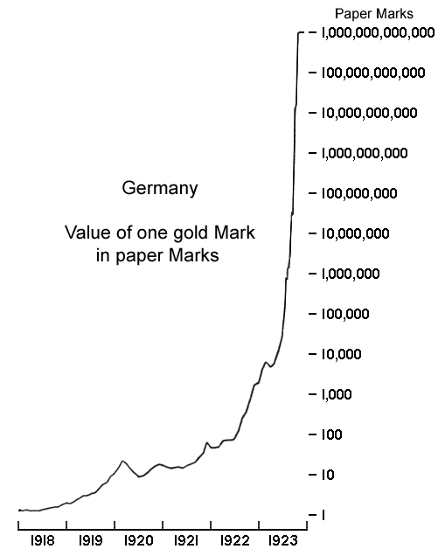
Value of a gold mark
Source Wikipedia Hyperinflation in the Weimar Republic retrieved October 10, 2014 from http://en.wikipedia.org/wiki/Hyperinflation_in_the_Weimar_Republic

Slide 43
German Hyperinflation: causes and timeline
Germany was asked by the Reparations Commission (May 1921) to pay for the cost of the First World War in gold or foreign currency in annual instalments of 2 billion goldmarks plus 26 percent of the value of its exports.
From August, 1921 German govt began to purchase foreign currency with paper marks.
From Jan 1923, no one wanted to sell gold or foreign currency for nearly worthless paper marks so reparations were paid for in goods.

Slide 44
Paper marks were only used to pay workers thus aggravating inflation more.
  One story is of a man who went to a café for a cup of coffee costing 5,000 marks. By the time he finished his coffee the price had risen to 8,000 marks.
  Workers would take their wages and rush to stores to buy whatever they could before prices rose more. They would then barter what they had with others who had what they needed.
By Nov 1923, 1USD was worth 4.2 billion marks.
A new currency, the Rentenmark replaced the Reichmark at a conversion rate of 1:1 trillion on Nov 1, 1923.

